Slide 1
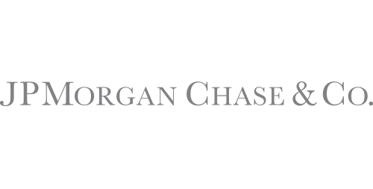

Chase Mobile App Addition
Marc A. Louis-Charles
Notes:
I’m a product manager for JP Morgan chase working in the Onyx unit. I will present a addition to the Chase pay app.

Slide 2
Agenda
Innovation
What is Cryptocurrency
Risks to the company
Market
Wireframes
roadmaps
OKRs

Slide 3
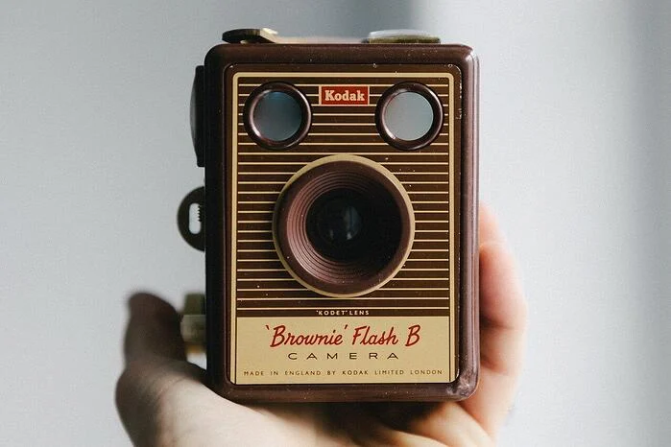
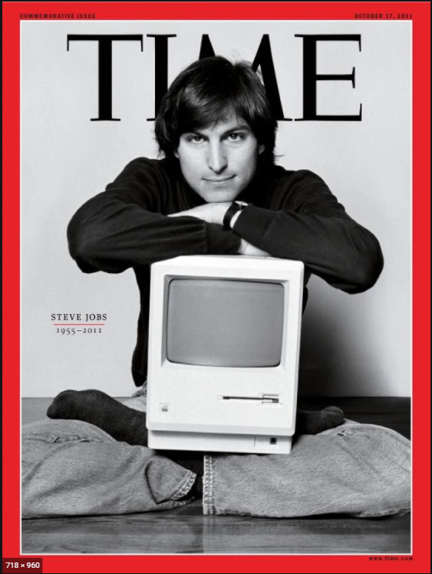
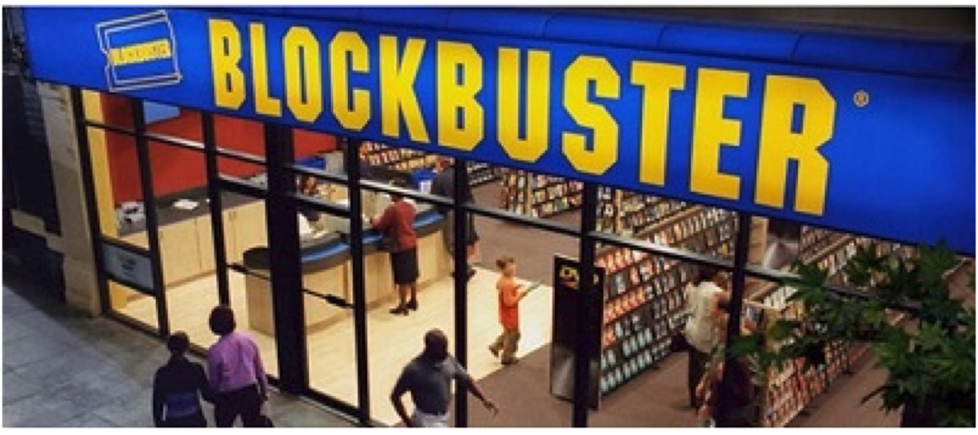
Innovation
Innovation distinguishes between a leader and a follower-Steve Jobs
Filed bankruptcy in 2012
Defunct by 2010
Notes:
At its peak in 2014 blockbuster employed 84,300 people worldwide and had 9,094 stores. Netflix approached in 2000 about an acquisition to be a online subsidiary but they was rejected.
Kodak develop the first digital camera in 1975, the leaders of Kodak failed to see digital photography as a disruptive technology. They denied the digital photography revolution for too long. A former VP is on record saying management thought it was a cute idea. we could not get approval to launch or sell it because of fear of the effects on the film market.
For JP Morgan not to go down the path of blockbuster and Kodak we must embrace innovation. Cryptocurrency is the innovation happening in our industry right now.

Slide 4
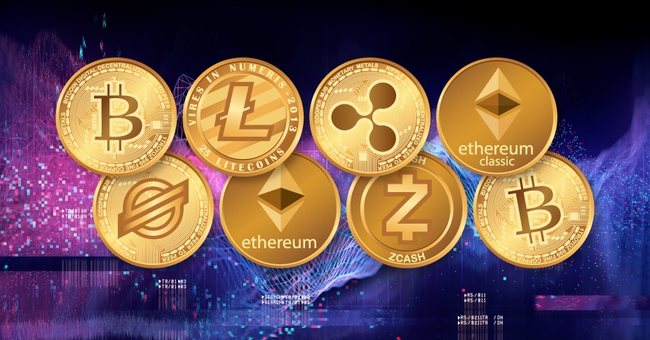
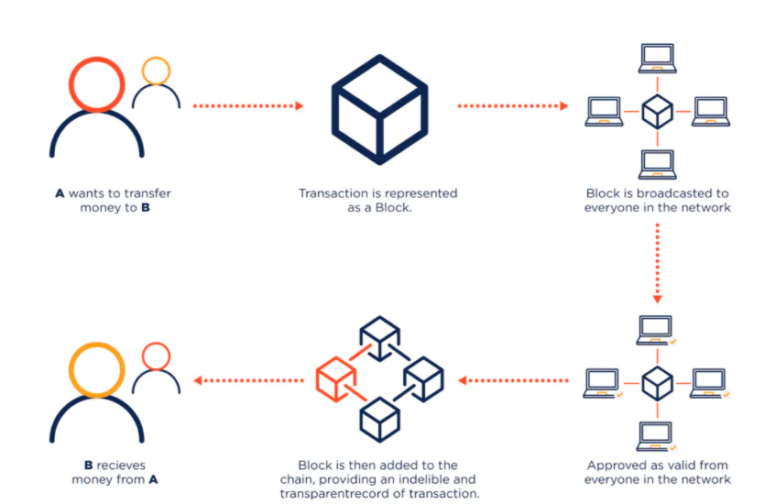
What is cryptocurrency
A cryptocurrency is a digital currency.
Cryptocurrency uses cryptography to create coins and secure transactions.
There are more than 2,000 cryptocurrencies.
Notes:
Digital: Cryptocurrencies are completely native to the internet. They have no physical form - although people do like to create little physical bitcoins
Cryptography-The art of writing (encrypting) and solving (decrypting) information for security purposes.
BlockChain-The technology behind cryptocurrency is called blockchain is, very simply, an online record of transactions. It is a distributed ledger system which keeps a record of every transaction which gets add to a block.

Slide 5
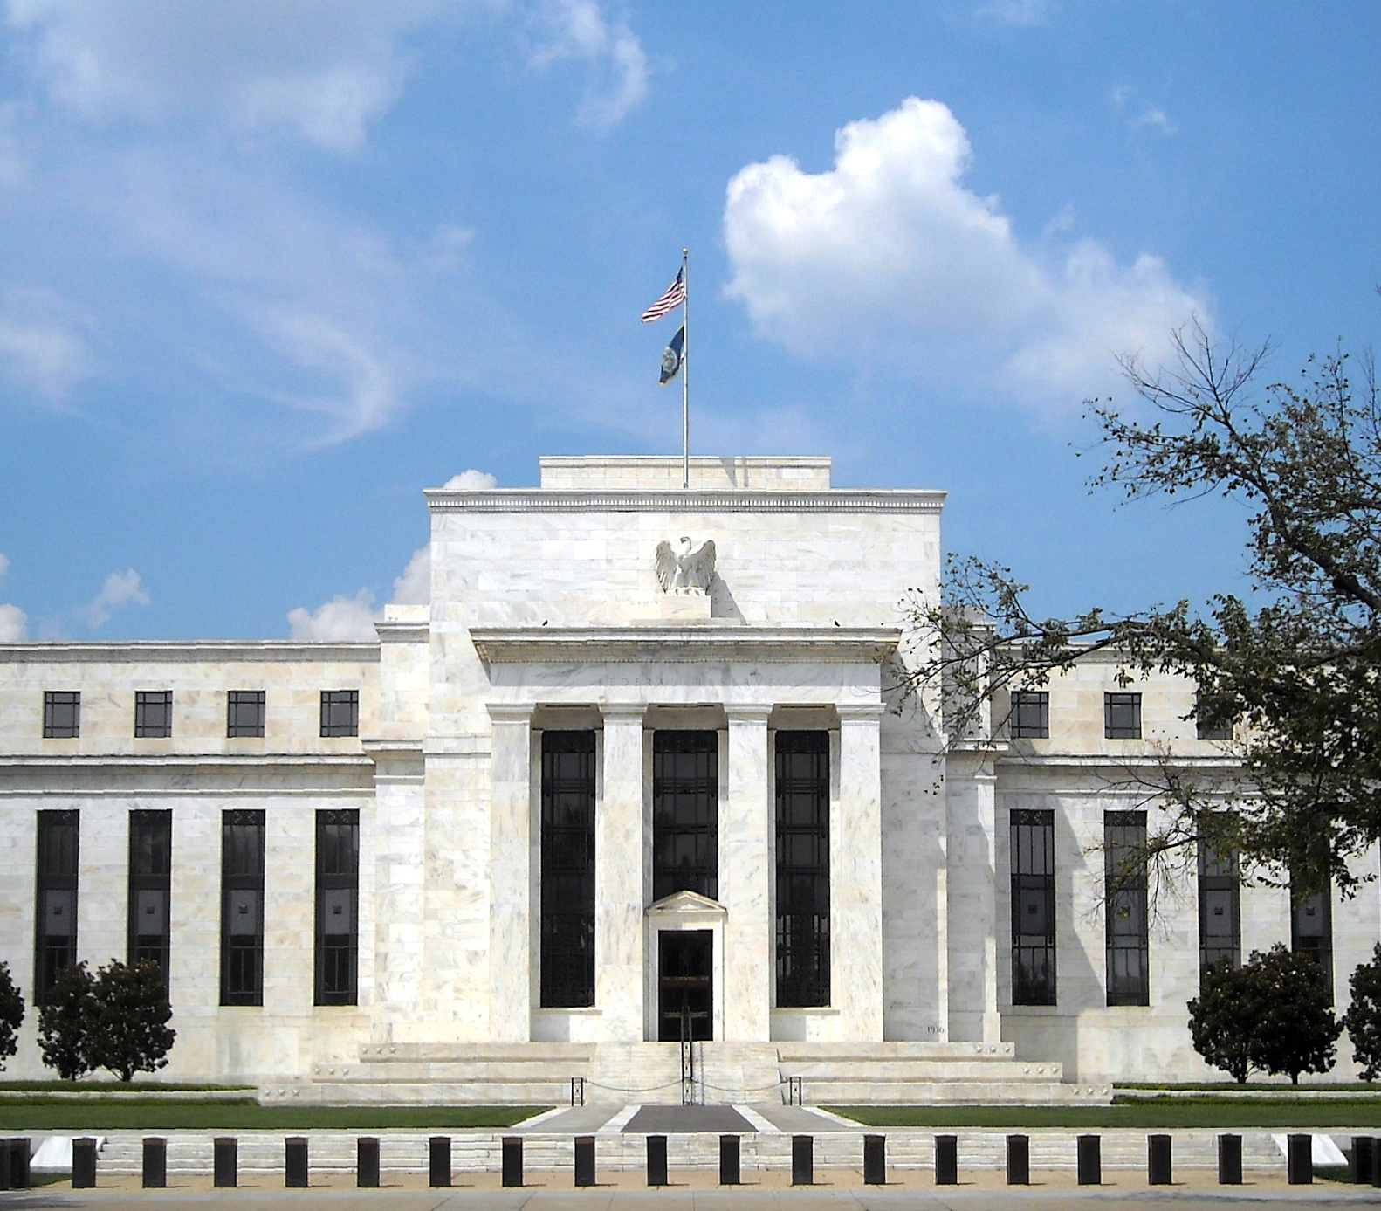
What is cryptocurrency
Cryptocurrency is not backed by a central bank or government to control or manage them.
The US Treasury classified cryptocurrency as a convertible decentralized virtual currency in 2013.
Under federal law cryptocurrency is defined as a commodity.
Notes:
Not controlled by the government-People in unstable countries where currencies are volatile can use cryptocurrencies as an alternative way to buy goods and services.
In the eyes of the federal government crypto is legal.
Bitcoin began it all: The first cryptocurrency widely adopted was bitcoin, created in 2009 by the fictitious person or group Satoshi Nakamoto

Slide 6
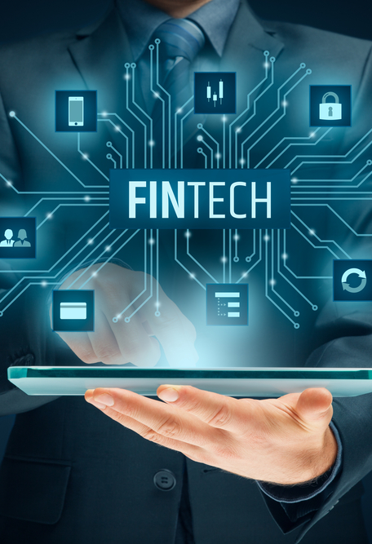
Risks to the company
JPMorgan Chase needs to spend more to modify or adapt its products to attract and retain clients and customers.
We need to match products and services offered by our competitors.
The current crypto asset market cap is well over 272 billion dollars.
Notes:
Both financial institutions and their non-banking competitors face the risk that payment processing and other services could be disrupted by technologies, such as cryptocurrencies, that require no intermediation.
Fintech firms are is a major threat to the bank in the world of payments. Fintech startups have spent the past few years catching up to legacy financial institutions, but it was the pandemic that accelerated the change and closed the gap. An increase in e-commerce and digital payments during the pandemic, coupled with an injection of government stimulus to consumers, fueled revenue growth at Square and its fintech companions.

Slide 7
Market and competitive Landscape
 | Chase Pay | PayPal | Square Cash App | Google Pay
Website
Connects to Facebook
User have profiles
Partners
Notes:
Paypal and Square has surpassed our banking competitors by market cap. We our the only bank to be bigger than paypal by market cap.
Amazon and Apple is a major isk to the bank
Now, more than ever, banks are well positioned to better understand and embrace crypto rather than segment all crypto as ‘bad’ or high-risk.
digital currencies is a new forms of competition that could, quite literally, give the bank a run for its money.

Slide 8
Market Estimation
TAM
$ 1,000 Trillion__
Money transfer industry
SAM
$715 M_
Money transfer users in United States U.K, Africa, Mexico and China.
SOM
$250 M_
Customer we will capture in United States, U.K, Africa, Mexico and China.
Notes:
The mobile payment market has more than doubled from $459 billion in 2015 to $1 trillion in 2019.
This makes the total addressable market (TAM) for the money transfer industry is $1 trillion.
The Serviceable Available Market (SAM) shows the amount of our market where our client’s based.
The Serviceable Obtainable Market (SOM) the potential in the short/medium term that we can realistically obtain with the resources that we are going to invest in obtaining clients.

Slide 9
Feedback from clients
Client Survey-MP
The feature of being able to send cryptocurrency to my family and friends in London and Africa. I want something secure and saving on fee’s would be great.
Client Survey-DNF
Ability to exchange crypto as easier as cash person to person, without fees and the same level of privacy.
Notes:
Trends we notice by having conversations with our clients

Slide 10
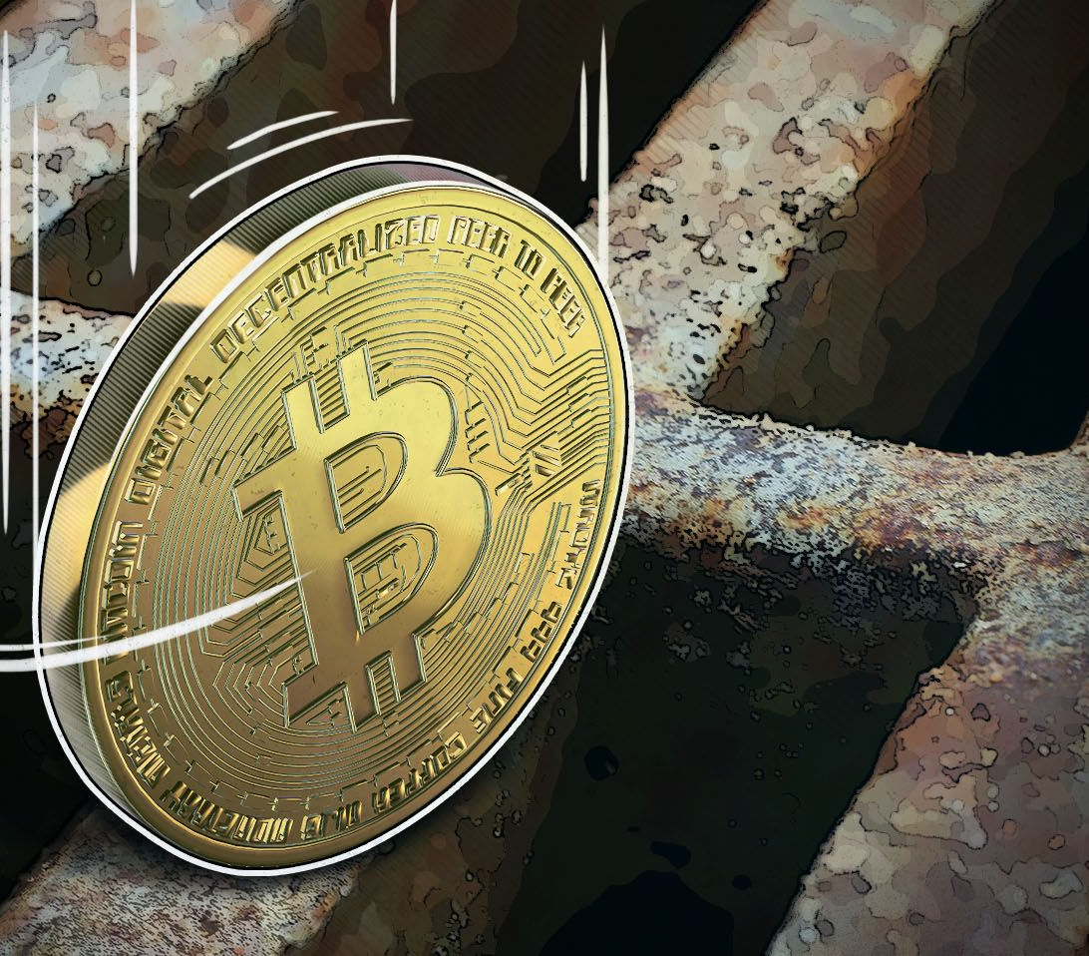
Problem
I need a way to transfer cryptocurrencies in the United States and overseas to other people using our Chase pay mobile app because I need a secure way to complete these transactions. I would like to save money on fees when I complete a transaction.
Notes:
There is a growth in customer demand, more people around the world is using cryptocurrencies.
This will allow us to pass saving to the customer in fees.
Our customers will be able to send crypto and review the blockchain information on their mobile app.

Slide 11
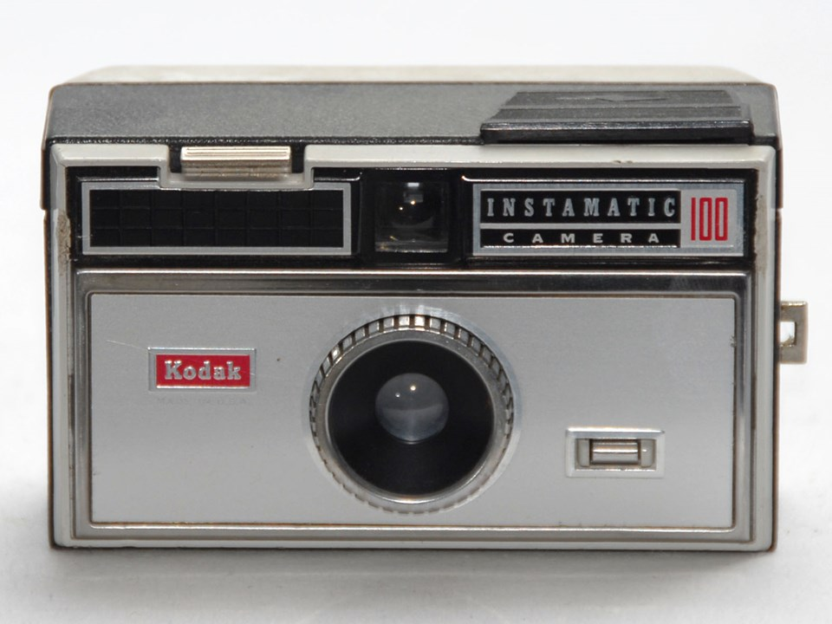
Solution
We believe that by allowing our customers to pay using crypto and send crypto currencies overseas. Implementing crypto e-wallets into our existing Chase mobile banking app.
It will allow the customers have a central place to do a safe cashless transactions without the need to pay high fees.
We do not want to end up like kodak once a leader in its industry now a follower
Notes:
I recommend that we integrate cryptocurrency e-wallets into our existing platforms to give our clients a more robust product offering.
The company spends around a 11 billion a year on blockchain technology, have partnerships with fintech firms and been studying it for several years

Slide 12
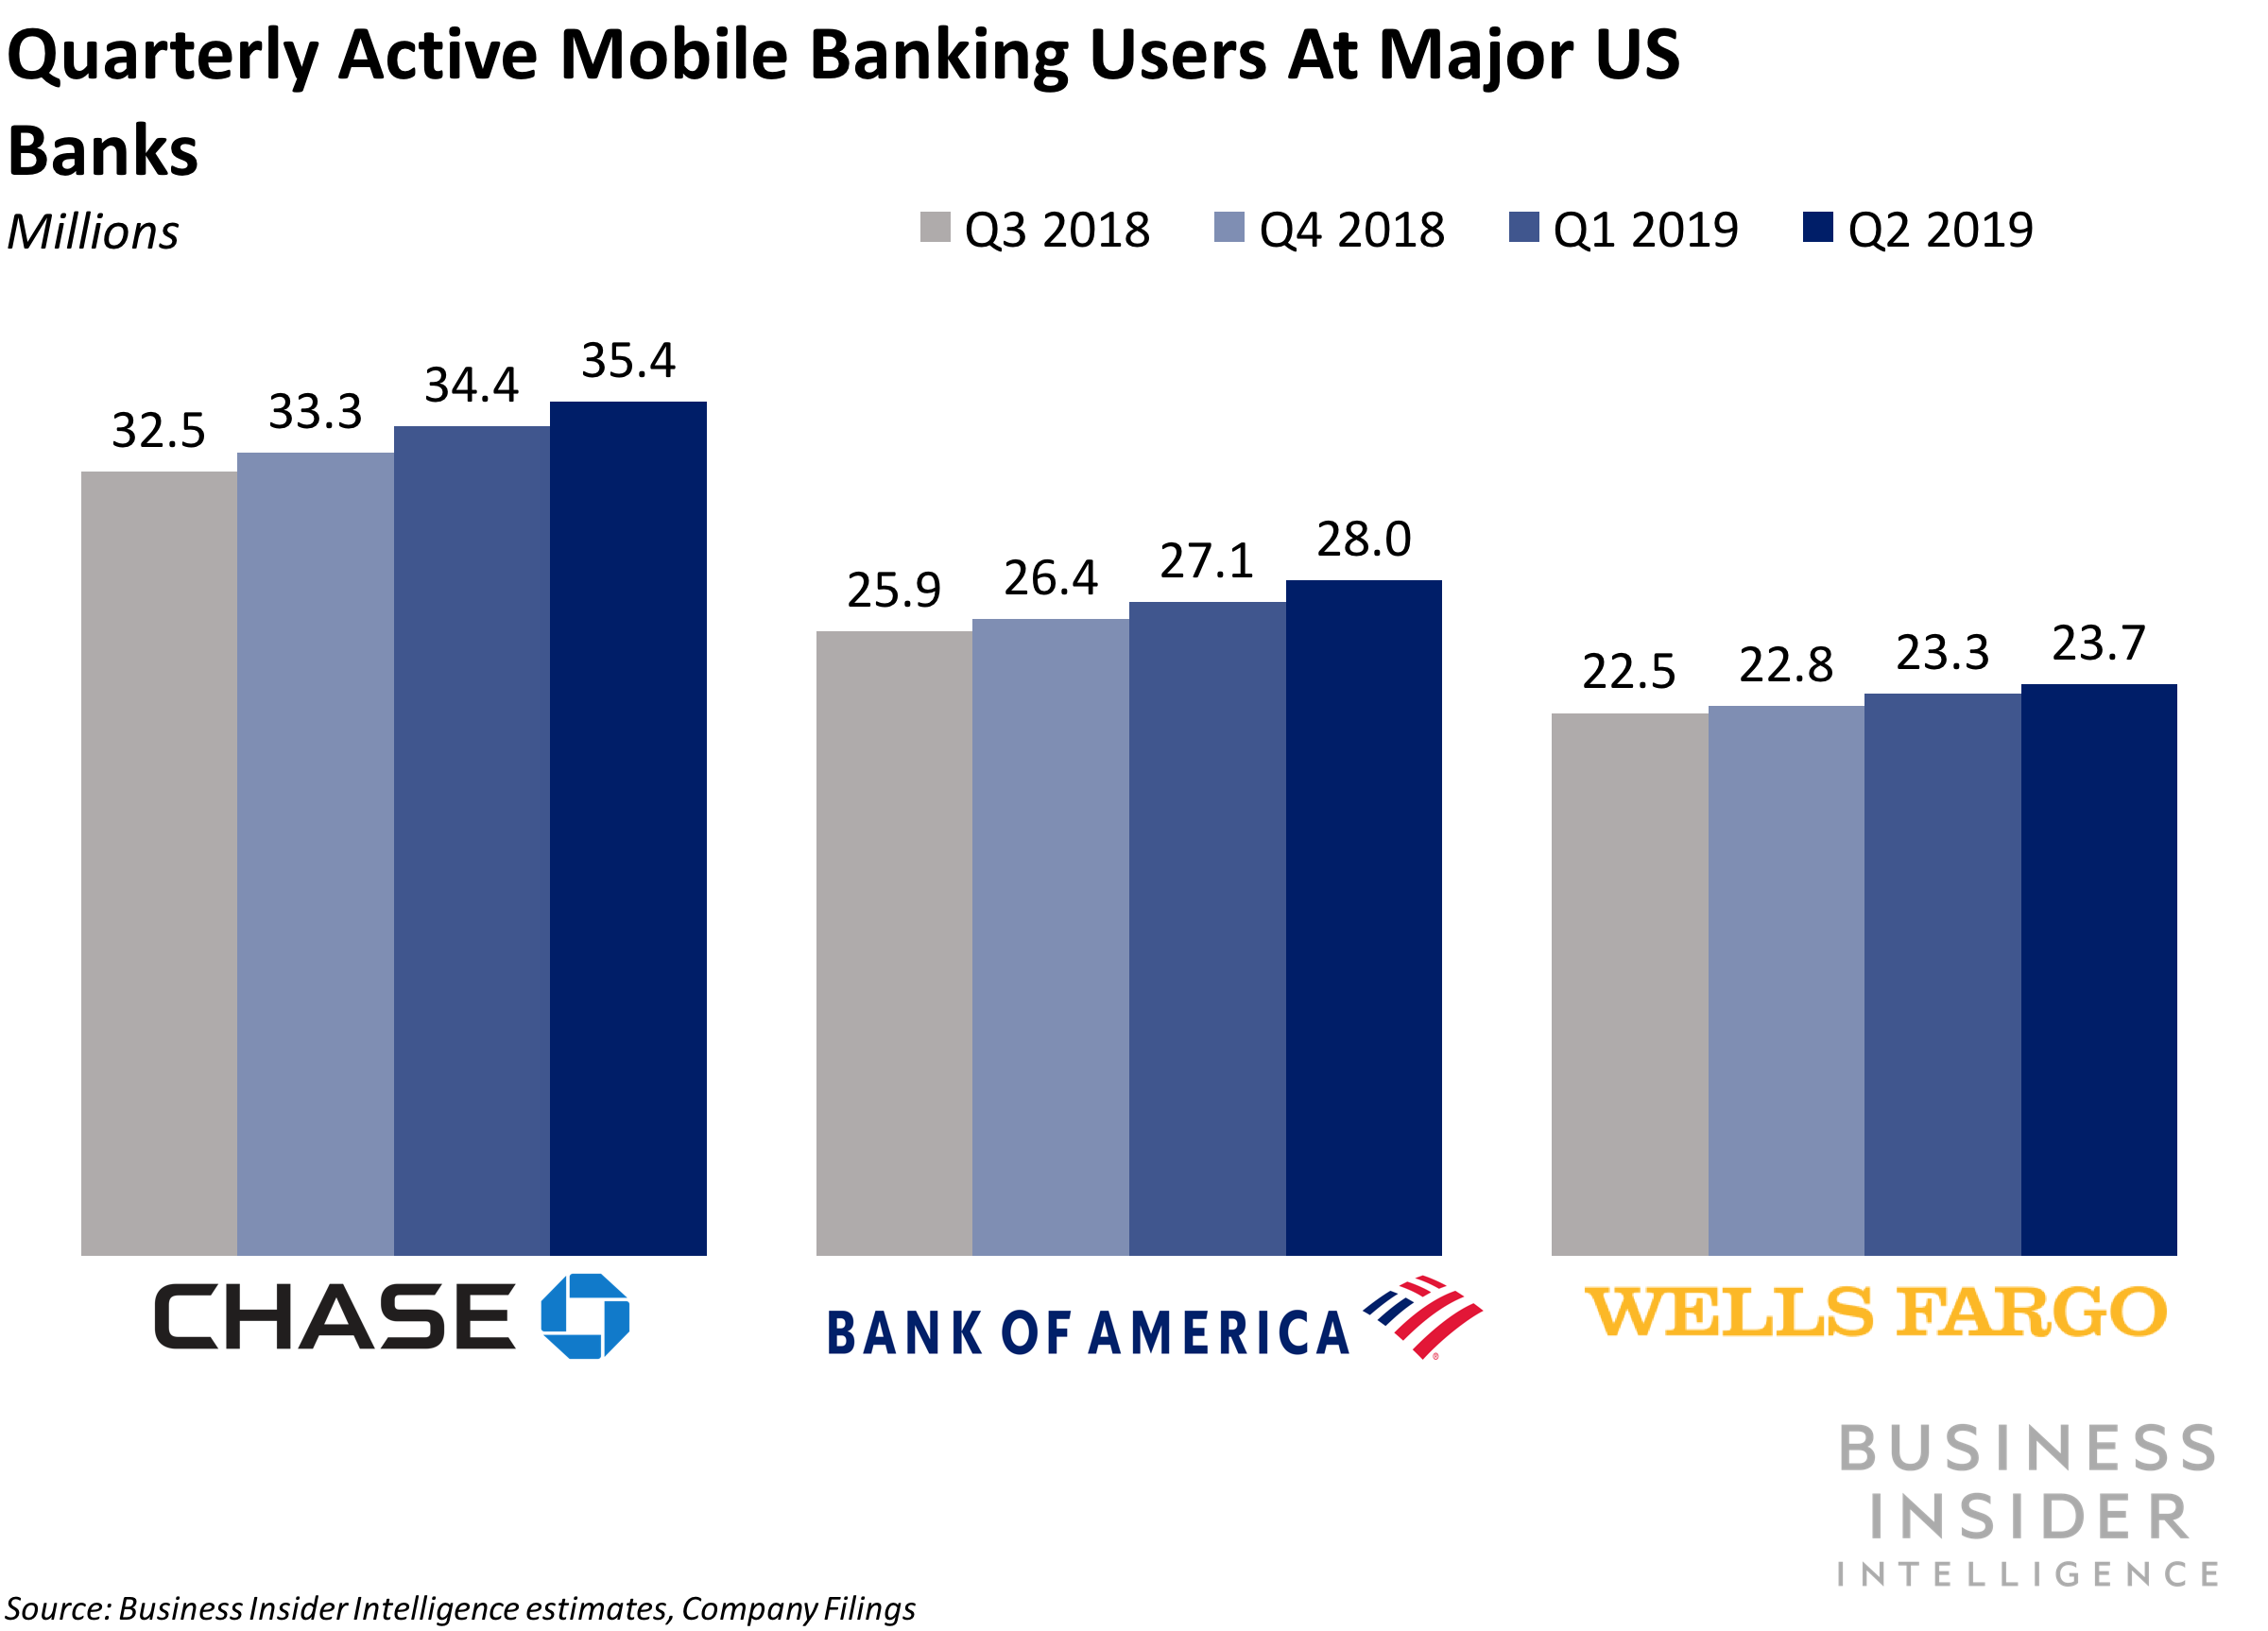
Target Audience
Our target audience is tech savvy customers in the age range of 25-45 year old.
Our product will focus on early adopters to late majority users of cryptocurrency.
JPMorgan Chase counts 51 million active digital customers as of Q2 2019, 35.4 million of whom use mobile banking.

Slide 13
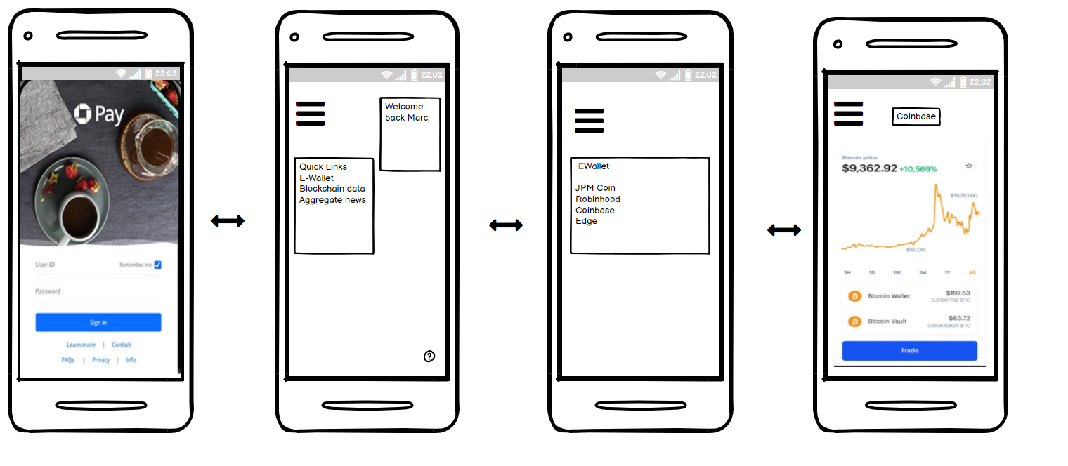
Wireframing: Going into Coinbase
Notes:
MVP
Connecting to several e-wallet’s: There are several e-wallet’s the app will connect to the most popular wallets
Aggregate crypto news: This will allow active users to be aware of industry news
Blockchain data: Allow my users to look at mining data
Buy fractional shares: Users will want the option to buy a share of certain type of currency

Slide 14
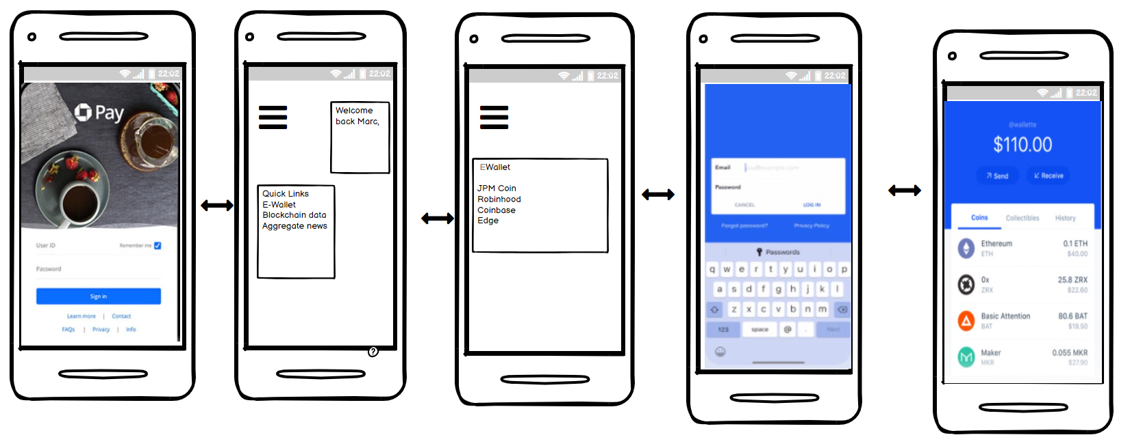
Wireframing : Sending and Receiving Cryptocurrencies

Slide 15
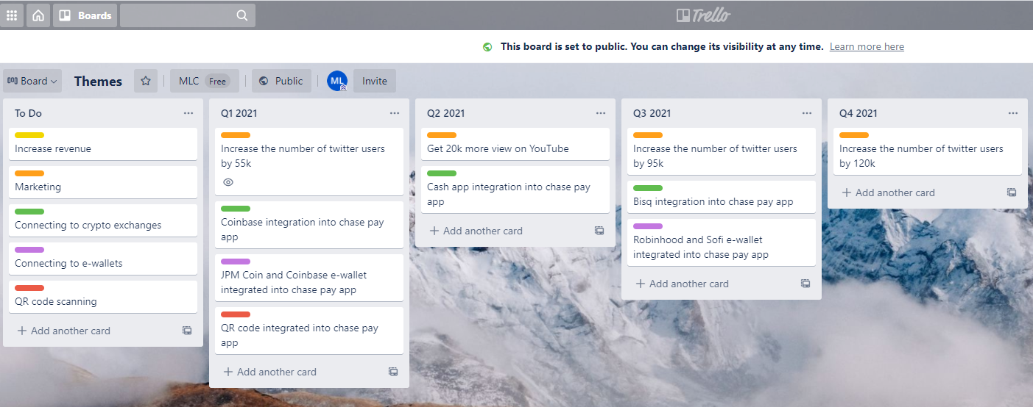
Roadmaps

Slide 16
Success- OKRs
Objective | Key Results
Grow our business | Reduce monthly churn rate by 3% to 4 % Grow monthly revenue by 200k
Increase engagement | Simplify user journey into the app Enhance the features of the chase pay app
Successfully launch updated version of Chase App | Get more than 300k new account sign ups
Please our customers | Collect feedback from 20 customers/month Maintain a NPS of 9

Slide 17
Thank You!

